Slide 1

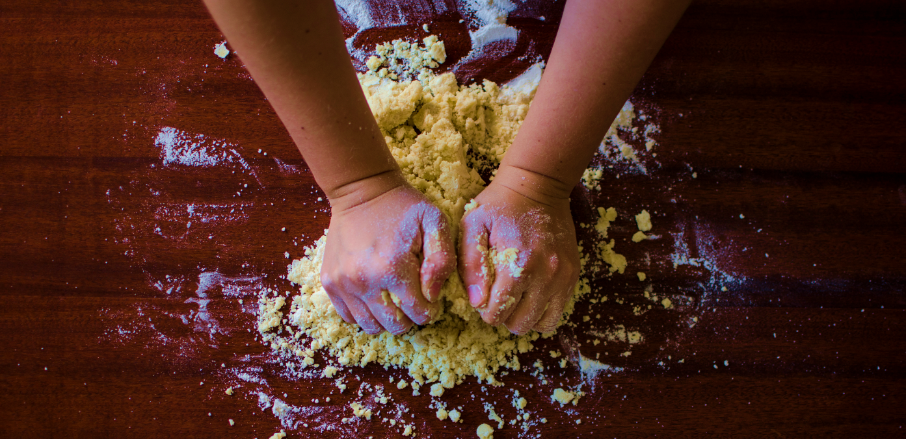
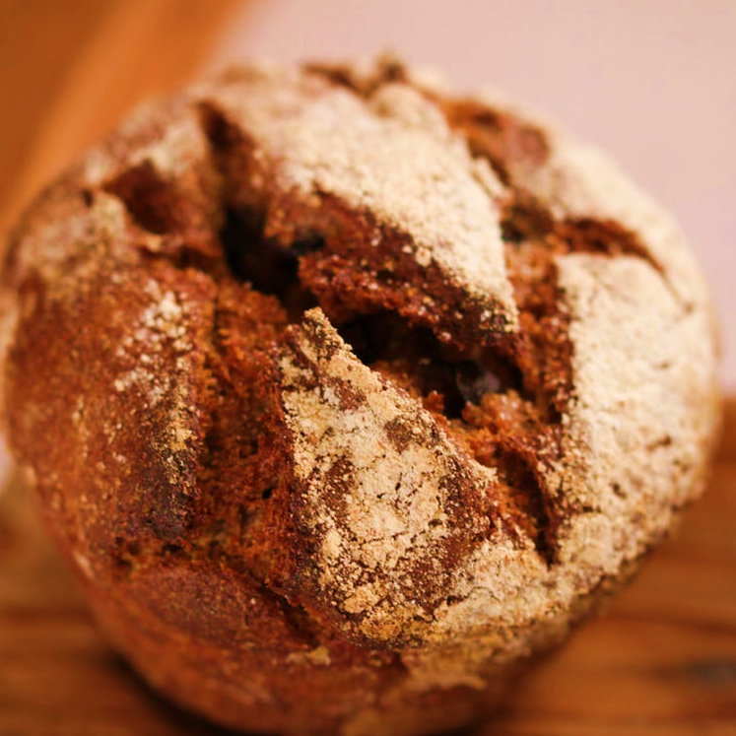
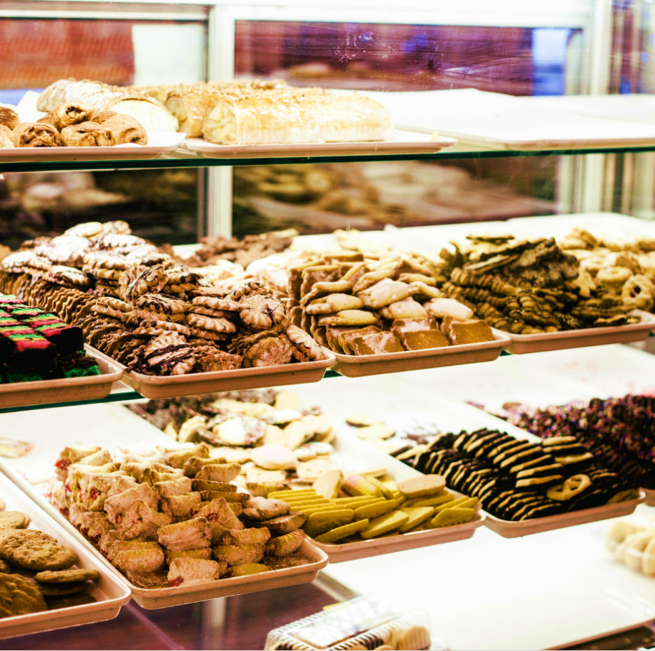
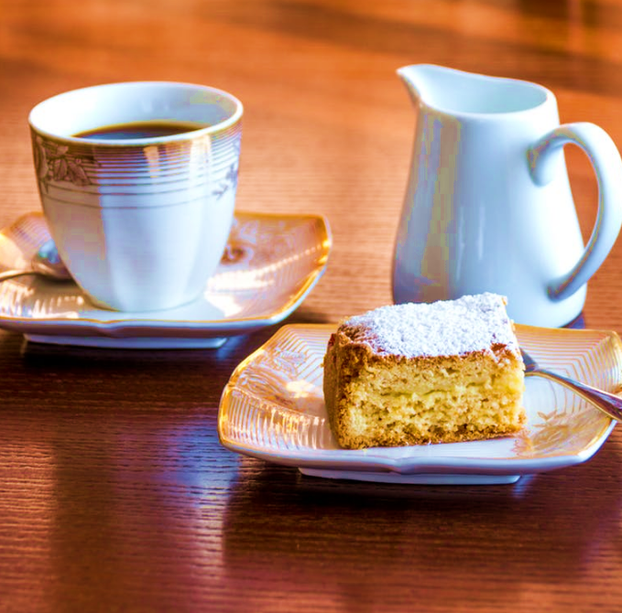





THE BAKERY
THE
BAKERY
EVERY COMMUNITY NEEDS A CENTER
FOR OVER 30 YEARS THE BAKERY HAS BEEN AT THE CENTER OF LIFE IN NEW PALTZ
When in New Paltz, don't miss a trip to The Bakery. Residents consider The Bakery, with its rustic outdoor cafe and beautiful gardens, to be the center of social life in New Paltz, a place to meet people, bump into old friends, or sit quietly and read the papers. Known since 1981 for great bagels, croissants, rolls, rugulah, danish and butter cookies, The Bakery includes a coffee bar and full lunch menu. Experience New Paltz! Visit The Bakery.
13a North Front Street New PaltZ, NY 12561
thebakery@ilovethebakery.com

